Slide 1
ANJUMAN COLLEGE OF ENGINEERING AND TECHNOLOGY DEPARTMENT OF APPLIED CHEMISTRY
SEMESTER-I
ENGINEERING CHEMISTRY
Presented By- Dr. Miss Nitu Gupta

Slide 2
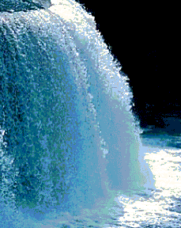
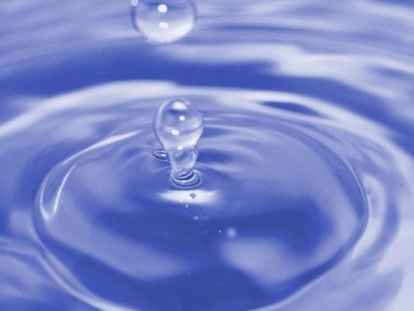
UNIT-1
WATER TECHNOLOGY

Slide 3
Lecture -1 Learning Objectives
To recall various water purification methods
To explain different methods for softening of hard water.
Identification of various boiler troubles and their prevention methods
To appraise the different desalination methods
To evaluate the hardness and lime & soda requirement for water softening

Slide 4
INTRODUCTION
Water is the most useful and also the most abundant of all chemical substances. It plays an important role in wide variety of natural processes and is essential for the growth of all animal and plant life.
Water is basic material needed by almost all industries. Water is used as a solvent in chemical or pharmaceutical industries.

Slide 5
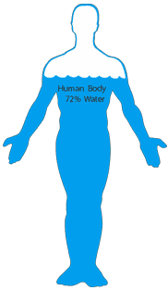
IMPORTANCE OF WATER
Water is of major importance to all living things. Up to 72 percent of the human body is water.
The drinking water should be totally clean, pure and free of any disease causing microbes and should be properly treated and disinfected before using it for drinking purpose.

Slide 6
SOURCES OF WATER
• SURFACE WATERS (LAKES, RIVERS, AND RESERVOIRS)
• GROUNDWATER (WELLS).

Slide 7
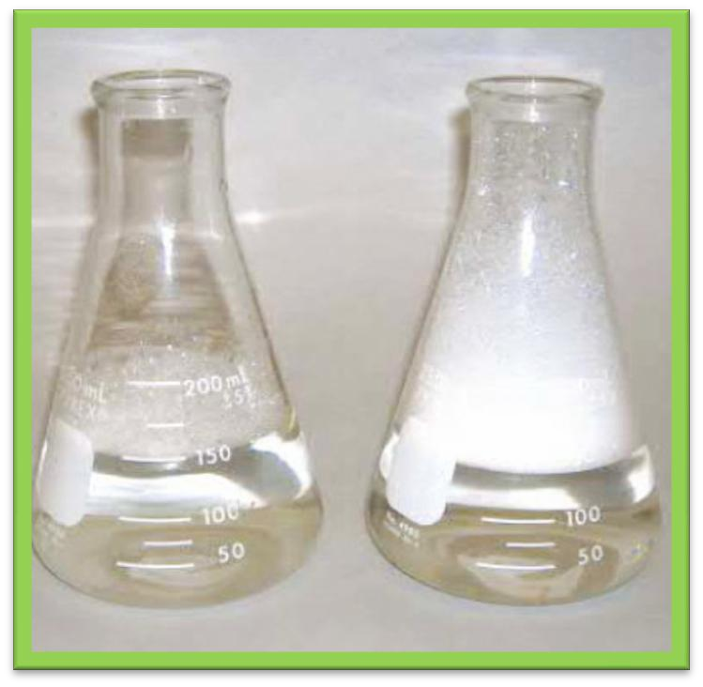
LECTURE-2 HARDNESS OF WATER
Hardness in water is that characteristic which prevents the lathering of soap, Thus, water which does not produce lather with soap solution readily forms a white curd is called “HARD WATER”
In simple words, “ Hardness is soap consuming capacity of water”

Slide 8
TYPES OF HARDNESS
HARDNESS
TEMPORARY PERMANENT
CARBONATE/ ALKALINE NON CARBONATE/
HARDNESS NON ALKALINE
HARDNESS

Slide 9
TEMPORARY HARDNESS
CAUSES : Soluble salts of bicarbonates of Ca, Mg and heavy metals.
REMOVAL : Simply boiling of water.
Ca(HCO3)2 → CaCO3+H2O+CO2
PERMANENT HARDNESS
CAUSES: Sulphates, nitrates chlorides of Ca , Mg , Fe And other heavy metals
REMOVAL: using chemical process.

Slide 10
UNITS OF HARDNESS
MOST COMMON UNITS OF HARDNESS :
Parts per million (PPM)/ Milligrams per liter
(Mg/liter)
Grains Per Imperial Gallon (gpg)
Degree Clarke's (0Cl)
Degree french (0Fr)
Degree Russian (0Ru)

Slide 11
LECTURE-3 METHODS OF PURIFICATION OF WATER

Slide 12
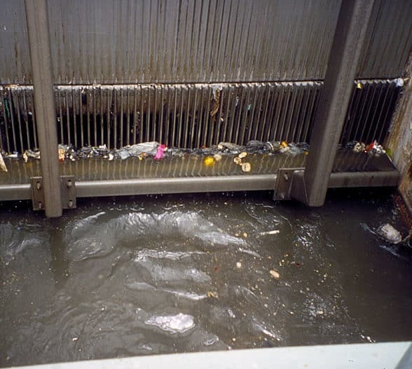
SCREENIG
“Screening is the process Of removing floating Materials from water.“

Slide 13
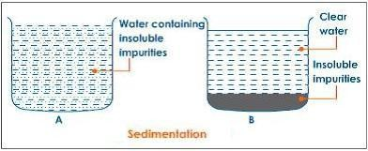
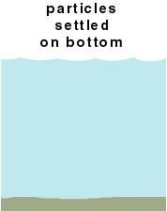
SEDIMENTATION
It is the process of removing suspended impurities by keeping water undisturbed for sufficient time in large tanks, when most of the suspended particles settle down due to gravity

Slide 14
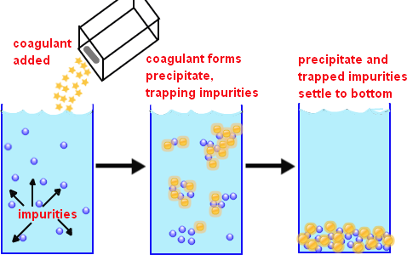
COAGULATION
Coagulation is the process of settling colloidal or fine particles from water by the addition of certain chemicals known as coagulants.

Slide 15
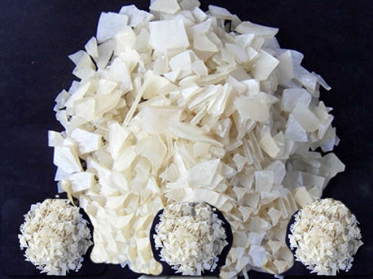
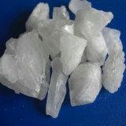
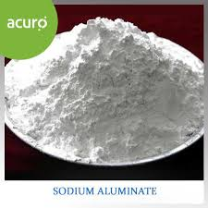
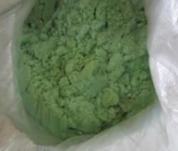
WIDELY USED COAGULANTS
A] ALLUMINIUM SULPHATE:
Al2(SO4)3
B] ALUM
(K2S04.AI2(S04)3.24H20)
C] SODIUM ALUMINATE (NaAIO2):
NaAIO2+ 2H2O → AI(OH)3 + NaOH
D] FERROUS SULPHATE
(FeS04):

Slide 16
LECTURE -4 STERILIZATION
The process of killing the bacteria and micro-organisms etc. from water is known as sterilization or disinfection of water.
It can be carried out by the following methods:
Boiling
Chlorination
Ozonization
Ultra-violet rays
Aeration

Slide 17
BOILING Boiling kills the disease causing germs and bacteria like cholera and typhoid. But this method is useful only for household purposes.
CHLORINATION
Chlorination can be carried out by the following methods:
Bleaching powder,
Chlorine gas/concentrated solution of chlorine and
Chloramines
Sodium Hypochlorite
Ozonisation:
Ultraviolet rays:
Aeration:

Slide 18
Mechanism of Chlorination
In all chlorination reaction, mechanism remains same as follows, where nacent oxygent act as a powerful killer of microorganism
CI2 + H2O → HOCI+ HCL
HOCI →+ HCI + [O]
Hypochlorous Acid Nacent Oxygen
By Bleaching Powder:-
CaOCI2 + H2O→Ca(OH)2 + CI2
CI2 + H2O → HOCI+ HCL
HOCI →+ HCI + [O]
By Chloramine:-
ClNH2 + 2H2O → HOCl + NH4Cl
HOCl → HCl + [O]
By Sodium Hypochlorite:-
NaOCl +H2O → HOCl + NaOH
HOCI →+ HCI + [O]
By chlorine gas/concentrated solution of chlorine:-
Cl2 + H2O HOCl + HCl
HOCI →+ HCI + [O]

Slide 19
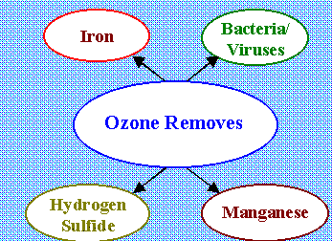
OZONIZATION
Ozoniation is an effective method of sterilization of water. Ozone (03) is unstable and it decomposes into molecular oxygen (02) and nascent oxygen [0]. 03 → 02 + [0] (Ozone) (Molecular oxygen ) (Nascent oxygen)
ADVANTAGES OF OZONIZATION
Ozone also act as a decolorizing and deodorizing agent.
It improves the taste of water.
In excess, it is not harmful, as it is unstable and
decomposes into oxygen.

Slide 20
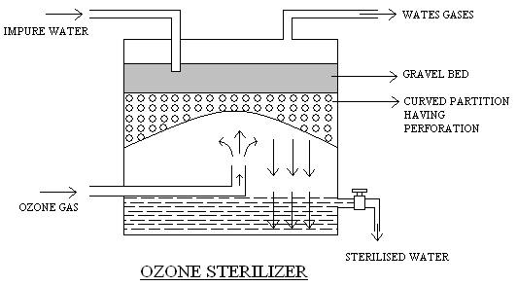
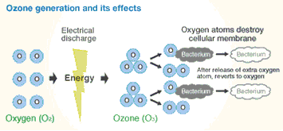

Slide 22
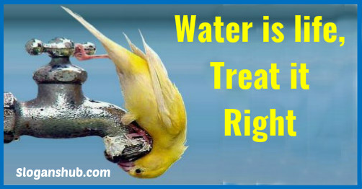
Dr. Nitu Gupta

